Slide 1
COUNTER WITH CIPHER BLOCK CHAINING-MESSAGE AUTHENTICATION CODE (CCM)
Presented by:
Divya Hari Kumar
https://github.com/divziv
https://www.linkedin.com/in/divyaharikumar/

Slide 2
TABLE OF CONTENTS
01
02
03
04
05
06
INTRODUCTION
STRUCTURE & WORKING
TECHNICAL BACKGROUND
CCM IN PRACTICE
ANALYSIS & COMPARISON
CONCLUSION

Slide 3
01.
INTRODUCTION

Slide 4
Introduction
Authenticated encryption aims to provide both data confidentiality and data origin authentication.
Many applications require both forms of security.
Authenticated Encryption: A term used to describe encryption systems that provide assurances of both secrecy and authenticity. The text then outlines different approaches to authenticated encryption, including:
Encrypt-then-MAC
Encrypt-and-MAC
MAC-then-encrypt
Independently and parallel encrypt and authenticate
Why it is needed: The requirement for both confidentiality and data origin authentication in many applications to achieve a higher level of security beyond just preventing eavesdropping. Some authenticated encryption schemes are as follows:
CCM
GCM

Slide 5

INTRODUCTION TO CCM
CCM (Counter with CBC-MAC) is a mode of operation for block ciphers that provides both encryption and message authentication.
Combines Counter Mode (CTR) for encryption and CBC-MAC for authentication.
Ensures confidentiality, integrity, and authenticity of data.

Slide 6
OVERVIEW OF THE CCM STRUCTURE
Operates in two phases:
CBC-MAC for authentication, then CTR for encryption.
Counter Mode (CTR):
Encrypts by incrementing counter per block.
Allows parallel encryption.
CBC-MAC:
Authenticates integrity using a chained block cipher MAC.

Slide 7
02.
STRUCTURE & WORKING

Slide 8
HOW CCM WORKS
ENCRYPTION
AUTHENTICATION
MAC
CTR mode encrypts plaintext by XORing with block cipher output of a counter.
MAC generated using CBC-MAC on plaintext and associated data.
MAC is appended to ciphertext.

Slide 9
COMPONENTS
Nonce (IV)
PLAINTEXT
Associated Data (AD)
Unique per message, prevents replay attacks.
Message to encrypt.
Authenticated but not encrypted.
1
2
3
4
5
KEY
MAC
Shared secret for encryption/authentication.
Ensures message integrity.

Slide 10
03.
TECHNICAL BACKGROUND

Slide 11
CTR MODE
CTR Mode
Useful for random access to encrypted data.
Counter Mode (CTR) turns block cipher into stream cipher:
Encrypts (IV + counter) and XORs with plaintext.
Allows parallel processing of blocks.

Slide 12
CBC-MAC
INTRO | STEPS | USES
CBC-MAC uses chained block cipher encryption to produce MAC. | Message is split into blocks. Each block is encrypted using prior ciphertext block. Last output is the MAC. | Only used for verifying integrity, not reversible.

Slide 13
04.
CCM IN PRACTICE

Slide 14
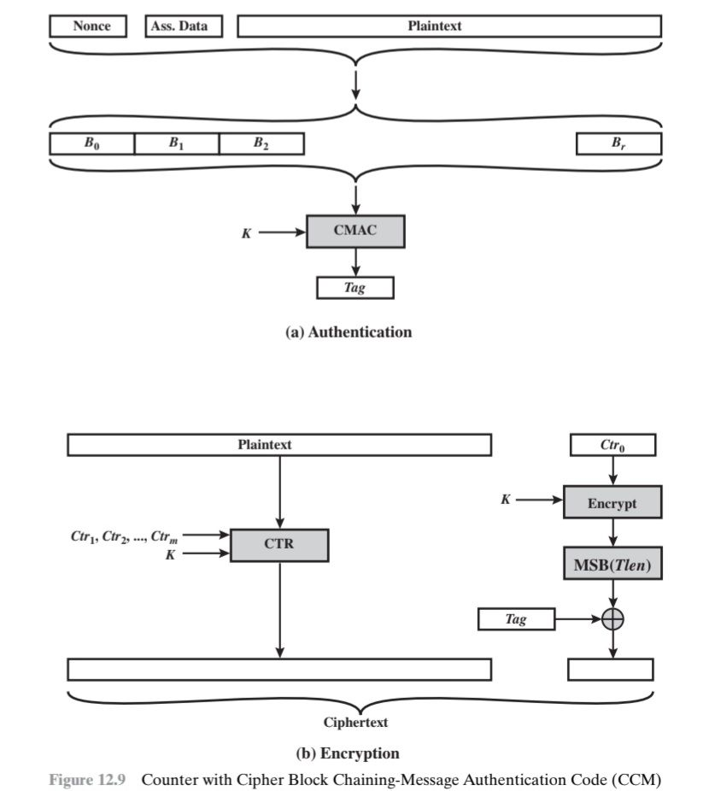
Authentication
Input: The authentication process takes three main inputs:
Nonce: A unique value used to ensure security against replay attacks.
Associated Data (Ass. Data): Data that needs to be authenticated but not encrypted (e.g., headers).
Plaintext: The message to be encrypted and authenticated.
Formatting: The Nonce, Associated Data, and Plaintext are combined and formatted into a sequence of blocks: B₀, B₁, B₂, ..., Bᵣ. The specifics of this formatting are detailed in the text preceding this figure. This formatting typically includes length indicators for the different input components.
CMAC: These formatted blocks (B₀ to Bᵣ) are then processed using the CMAC (Cipher-based Message Authentication Code) algorithm along with a secret key K. CMAC is a variation of CBC-MAC designed to be secure for messages of variable length.
Tag: The output of the CMAC operation is the Tag, which is the Message Authentication Code (MAC) that provides data integrity and authenticity.

Slide 15
Authentication
MAC Generation (Authentication):
Apply the formatting function F(A, P) to produce the blocks B₁, B₂, ..., Bᵣ. This step prepares the associated data (A) and the plaintext (P) for the MAC calculation.
Apply the CBC-MAC function to B₁, ..., Bᵣ using the key K and an initial value. This generates a MAC value.
Apply a formatting function to the initial counter value and the MAC to produce the authentication tag T.

Slide 16
Encryption
Input: The encryption process takes the Plaintext, a Nonce, and the secret key K as input.
Counter Generation: A series of counter values (Ctr₀, Ctr₁, Ctr₂, ...) are generated based on the Nonce. The initial counter value (Ctr₀) is derived from the nonce. Subsequent counter values are typically incremented.
Encryption (CTR Mode): The counter values are then encrypted using the secret key K in Counter (CTR) mode. This produces a keystream. The Plaintext is XORed with this keystream to produce the Ciphertext.
Tag Integration: The Tag generated during the authentication process is then incorporated into the final output. The diagram shows the Tag being XORed with the Most Significant Bits (MSB) of a specific length (Tlen) of the encrypted counter (likely Ctr₀ or a related value). This is a simplified representation of how the tag is typically appended to the ciphertext in CCM. The full details of how the tag is combined with the ciphertext are usually specified in the CCM standard.

Slide 17
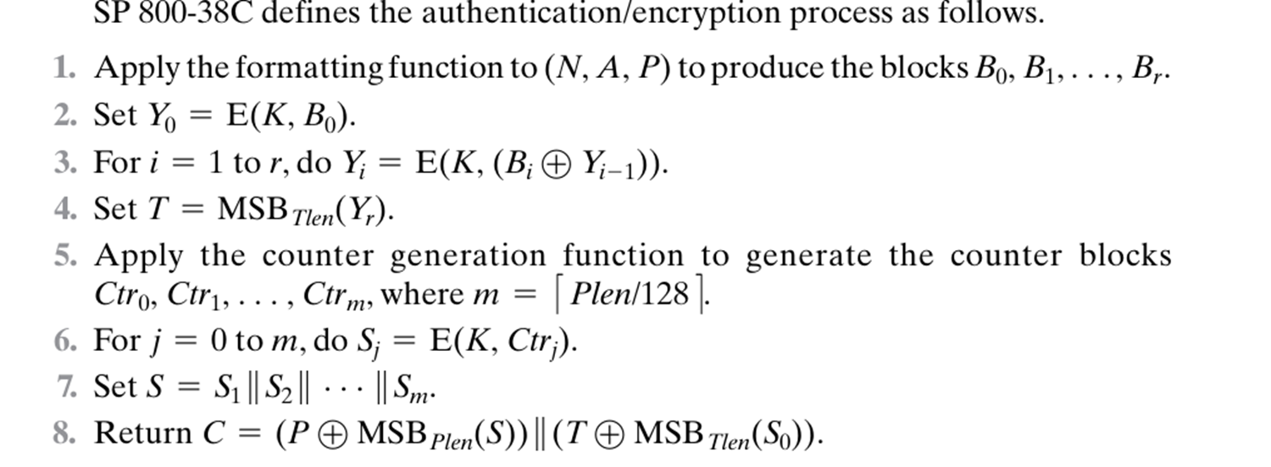
Authentication/Encryption
Process

Slide 18
Encryption
Apply the formatting function to the nonce N and the plaintext P to produce the blocks P₁, P₂, … . This prepares the plaintext for encryption using the counter mode.
Apply the counter generation function to generate the counter blocks Ctr₁, Ctr₂, … based on the nonce N.
Encrypt the counter blocks using the key K to produce the keystream S₁, S₂, … .
The ciphertext blocks C₁, C₂, ..., are obtained by XORing the plaintext blocks P₁, ..., with the keystream S₁, … .
Return the concatenation of the ciphertext C₁, ..., and the authentication tag T.

Slide 19
ENCRYPTION
CTR mode encrypts plaintext into ciphertext.
Sender selects a unique nonce.
Ciphertext + MAC sent to receiver.
1
2
3
4
5
MAC is computed over plaintext and AD with CBC-MAC.
MAC is appended to ciphertext.

Slide 20
DECRYPTION
1
3
Receiver receives ciphertext and MAC.
Computes MAC over plaintext and AD.
2
4
Decrypts ciphertext using CTR + nonce.
Compares computed MAC with received MAC.

Slide 21
Decryption
The figure illustrates that CCM achieves authenticated encryption by:
Generating a MAC (Tag) using CMAC over the combined Nonce, Associated Data, and Plaintext.
Encrypting the Plaintext using CTR mode based on a Nonce and a series of counters.
Appending the generated Tag to the Ciphertext.
The receiver, upon receiving the Ciphertext and Tag, would perform the decryption using the same Nonce and key and then independently calculate the MAC of the received Ciphertext and Associated Data. If the calculated MAC matches the received Tag, the integrity and authenticity of the data are verified.

Slide 22
Decryption
The decryption process involves decrypting the ciphertext using CTR mode with the same nonce and key. The verification process involves recalculating the MAC on the received ciphertext and associated data and comparing it to the received tag. If they match, the data is considered valid.
CCM combines CBC-MAC for authentication and CTR for encryption.
The MAC is generated based on the associated data and the plaintext.
The plaintext is encrypted using CTR mode with a nonce and counter.
The MAC (authentication tag) is appended to the ciphertext.
Decryption involves reversing the CTR encryption.
Verification involves recalculating the MAC and comparing it to the received tag.

Slide 23
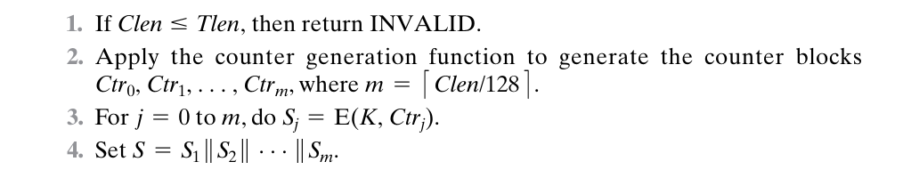
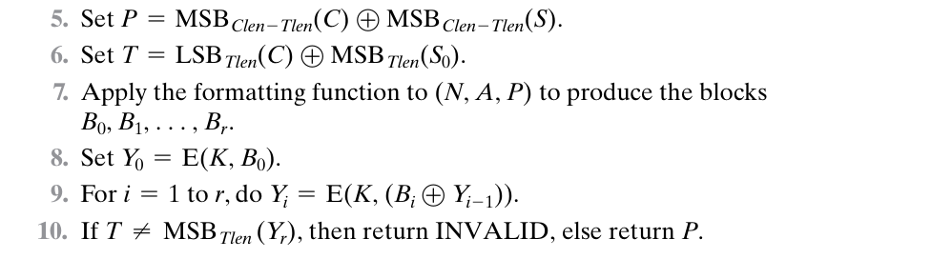
Decryption/Verification Process

Slide 24
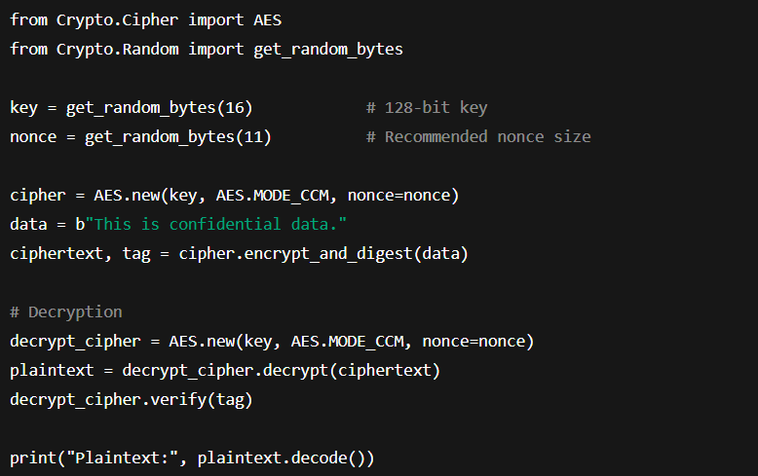
PRACTICAL IMPLEMENTATION

Slide 25
05.
ANALYSIS & COMPARISON

Slide 26
SECURITY
CTR
CBC-MAC
CTR mode ensures confidentiality.
CBC-MAC ensures message integrity.
PT, CT
NONCE
Resistant to chosen-plaintext and ciphertext attacks.
Requires strict nonce management.

Slide 27
ADVANTAGES & LIMITATIONS
ADVANTAGES
LIMITATIONS
Efficient, supports parallel processing.
Combines encryption and authentication.
No padding needed for encryption.
Authenticates associated data.
Used in IPsec, TLS, Wi-Fi security.
Less efficient for large data sets.
Depends on fixed block size (e.g., AES).
Critical nonce management; reuse risks full compromise.

Slide 28
USE CASES
1
2
3
4
5
Wi-Fi security (WPA2/CCMP)
IPsec VPNs
TLS/HTTPS traffic
Bluetooth Low Energy
Disk Encryption

Slide 29
CCM vs. OTHER MODES
 | CCM (Counter with CBC-MAC) | GCM (Galois/Counter Mode) | EAX
Authentication Method | Sequential | Galois field multiplication | One-key CBC-MAC variant
Parallel Processing | Limited (authentication is sequential) | Fully parallelizable | Limited (MAC is sequential)
Speed & Efficiency | Moderate | Very fast, optimized for high-speed use | Moderate
Flexibility of MAC Length | Moderate | High | Moderate

Slide 30
SECURITY ANALYSIS
CRYPTANALYSIS OF CCM
Main risk: nonce reuse.
Can lead to key recovery or loss of confidentiality.
Security depends on AES and correct implementation.

Slide 31
06.
CONCLUSION

Slide 32
MODERN ROLE
CCM IN MODERN CRYPTOGRAPHY
Standardized in NIST SP 800-38C.
Still used in secure protocols.
Balances security with efficiency in embedded systems.

Slide 33
CCM BEST PRACTICES
Unique nonce per message is mandatory.
Use strong key management practices.
Handle MAC failures securely.
Prefer AES with 128/256-bit keys.

Slide 34
CONCLUSION
CTR (encryption)
CCM = +
CBC-MAC (authentication).
Provides confidentiality and integrity in one mode.
Relevance continues in secure and resource-limited environments.

Slide 35
REFERENCES
Book:
Cryptography and Network Security: Principles and Practices

Slide 36

THANK
YOU!

